Slide 1
Week 1 - Overview
COMP2006 – Introduction to C++

Slide 2
Week 1 - Overview
MTP:
1. Review of the Course Syllabus
2. Introduction to C/C++ including data types, declarations, and operators
3. Get the compiler environment operational

Slide 3
1. Review of Course Syllabus
Course syllabus reviewed in class
Both the syllabus and course outline are posted to Blackboard which has been enabled
Pay close attention to the due dates for the assignments as listed on the course calendar
The course calendar is up to date and any changes during the term will be both updated through an announcement and on the calendar

Slide 4
Introduction to C/C++: Background
Why Use a Language Like C++?
1. Conciseness: programming languages allow us to express common sequences of commands more concisely. C++ provides some especially powerful shorthands.
2. Maintainability: modifying code is easier when it entails just a few text edits, instead of rearranging hundreds of processor instructions. C++ is object oriented compared to C which is procedural.
3. Portability: diﬀerent processors make diﬀerent instructions available. Programs written as text can be translated into instructions for many diﬀerent processors; one of C++’s strengths is that it can be used to write programs for nearly any processor.
C++ is a high-level language (ie. it isn’t direct register accessing such as Assembly): when you write a program in it, the shorthands are suﬃciently expressive that you don’t need to worry about the details of processor instructions. C++ does give access to some lower-level functionality than other languages (e.g. memory addresses).

Slide 5
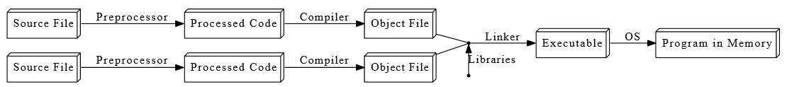
Introduction to C/C++: Background
The object file is an intermediate file that represents an incomplete copy of the program with markers indicating dependencies
The linker takes object files and compiled libraries to produce the final program which can be run by the OS
Parsing is the process during which the compiler reads the file
In C++ these steps are done ahead of time lending to faster execution times

Slide 6
Introduction to C/C++: Background
C++ is immensely popular, particularly for applications that require speed and/or access to some low-level features although for optimisation ASM would be used (although this loses portability)
C++ was created in 1979 by Bjarne Stroustrup, at ﬁrst as a set of extensions to the C programming language. We will be looking at both C and C++ structures throughout this course.
Visual applications can be created using C++ (ie. Visual C++) but portability is decreased. We will be focusing on console based programs for this course only.
As a primary interest is portability we will not be using Windows defined C++ libraries but rather we will stick to general libraries available cross platform
Important: Everything in C++ is case sensitive as such intCounter and IntCounter are not the same variable

Slide 7
Introduction to C/C++: Tokens
C/C++ is very similar to other languages you have studied.
Tokens are the minimals chunk of program that have meaning to the compiler – the smallest meaningful symbols in the language (there are 6), and include:
Keywords – int, double, for, auto
Identifiers – cout, std, x, myFunction
Literals – “hi”, ‘c’, 0, 23.4
Operators – +, -, &&, %, <<
Punctuation/Seperators – {}, (), , ;
Whitespace – spaces, tabs, newlines, comments

Slide 8
Introduction to C/C++: Syntax Overview
1. // my first program in C++
#include <iostream>
int main()
{
std::cout << "Hello World!";
}

Slide 9
Introduction to C/C++: Syntax Overview
Line 1: // my first program in C++
Is the comment in C/C++. Two comment options are available: // line comment, and /* block comment */
Line 2: #include <iostream>
The # represents a directive read and interpreted by the preprocessor (interpreted prior to compilation). The #include <iostream> directive indicates to include the header iostream (standard C++ library) that allows for standard input and output operations.
NB. Blank lines are not interpreted by the compiler.

Slide 10
Introduction to C/C++: Syntax Overview
Line 3: int main()
Initiates the declaration of a function which in this case is called “main” which is an integer type.
The function named main is a special function in all C++ programs; it is the function called when the program is run. The execution of all C++ programs begins with the main function, regardless of where the function is actually located within the code.
Lines 5 and 7: { and }
All code encapsulated between these braces are part of the main function. All functions use braces to indicate the beginning and end of their definitions.

Slide 11
Introduction to C/C++: Syntax Overview
Line 6: std::cout << "Hello World!";
This statement has three parts: First, std::cout, which identifies the standard character output device (usually, this is the computer screen). Second, the insertion operator (<<), which indicates that what follows is inserted into std::cout. Finally, a sentence within quotes ("Hello world!"), is the content inserted into the standard output. Notice that the statement ends with a semicolon (;). This character marks the end of the statement, just as the period ends a sentence in English. All C++ statements must end with a semicolon character. One of the most common syntax errors in C++ is forgetting to end a statement with a semicolon.
NB. Statements are executed sequentially
NB. The ; is used to separate statements. It is suggested to space out the code for legibility. Preprocessor directives (#) must be specified in their own line and, because they are not statements, do not have to end with a semicolon (;). The same occurs for the {} function markers.

Slide 12
Introduction to C/C++: Using Namespace Std
Line 6A: std::cout << "Hello World!";
The above uses a qualified object (std::cout) within the namespace std.
This can be re-written as a unqualified object:
Line 6B: cout << "Hello World!";
This works as cout is member of the standard C++ library declared within a namespace. You can either qualify each use from the library or introduce visibility of its components. This is the most common approach (6B) but the choice is yours.
Place the following at the beginning of your code to have 6B work: using namespace std;

Slide 13
Introduction to C/C++: Strings
Line 6C: std::cout << "Hello World! \n";
The string is encapsulated between the “”
The \n indicates a newline character and is an example of an escape sequence – a symbol used to represent a special character in a text literal.
Here are all the C++ escape sequences which you can include in strings:
Escape Sequence Represented Character
\a System bell (beep sound)
\b Backspace
\f Formfeed (page break)
\n Newline (line break)
\r “Carriage return” (returns cursor to start of line)
\t Tab
\\ Backslash
\’ Single quote character
\" Double quote character
\some integer x The character represented by x

Slide 14
Introduction to C/C++: Variables
Defined: variable as a portion of memory to store a value (this concept is very important to C/C++)
A valid identifier is a sequence of one or more letters, digits, or underscore characters (_).
Spaces, punctuation marks, and symbols cannot be part of an identifier.
In addition, identifiers shall always begin with a letter. They can also begin with an underline character (_), but such identifiers are -on most cases- considered reserved for compiler-specific keywords or external identifiers, as well as identifiers containing two successive underscore characters anywhere.
In no case can they begin with a digit.
Ex. intA, i, _score etc.

Slide 15
Introduction to C/C++: Variables
General keywords (and un-usable as a variable name):
alignas, alignof, and, and_eq, asm, auto, bitand, bitor, bool, break, case, catch, char, char16_t, char32_t, class, compl, const, constexpr, const_cast, continue, decltype, default, delete, do, double, dynamic_cast, else, enum, explicit, export, extern, false, float, for, friend, goto, if, inline, int, long, mutable, namespace, new, noexcept, not, not_eq, nullptr, operator, or, or_eq, private, protected, public, register, reinterpret_cast, return, short, signed, sizeof, static, static_assert, static_cast, struct, switch, template, this, thread_local, throw, true, try, typedef, typeid, typename, union, unsigned, using, virtual, void, volatile, wchar_t, while, xor, xor_eq

Slide 16
Introduction to C/C++: Variables
Very important: The C++ language is a "case sensitive" language. That means that an identifier written in capital letters is not equivalent to another one with the same name but written in small letters.
Ex. The variables SUM, sum, and Sum represent 3 unique instances and are not interchangeable.

Slide 17
Introduction to C/C++: Variables
As with other programming languages the proper use of variables is vital. This is particularly important for SoC and optimisation.
Fundamental data types are basic types implemented directly by the language that represent the basic storage units supported natively by most systems. They can mainly be classified into:
Character types: They can represent a single character, such as 'A' or '$'. The most basic type is char, which is a one-byte character. Other types are also provided for wider characters.
Numerical integer types: They can store a whole number value, such as 7 or 1024. They exist in a variety of sizes, and can either be signed or unsigned, depending on whether they support negative values or not.
Floating-point types: They can represent real values, such as 3.14 or 0.01, with different levels of precision, depending on which of the three floating-point types is used.
Boolean type: The boolean type, known in C++ as bool, can only represent one of two states, true or false.

Slide 18
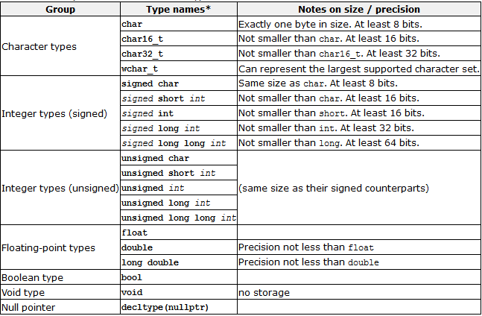
Introduction to C/C++: Variables
Here is the complete list of fundamental types in C++ (presented smallest to largest of each set):
signed short int can be abbreviated as signed short, short int, or simply short; they all identify the same fundamental type.

Slide 19
Introduction to C/C++: Variables
The capacity of the data types (non-Char) depends on the architecture the programming will run on
Allows for portability, flexibility, on current and future architectures
Type sizes above are expressed in bits; the more bits a type has, the more distinct values it can represent, but at the same time, also consumes more space in memory (key idea)
nullptr and void will be discussed more later in the course

Slide 20
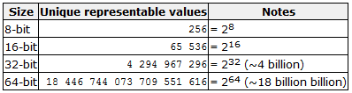
Introduction to C/C++: Variables
Ex. Unsigned 16-bit int: 0 to 65,535
Signed 16-bit int: -32,768 to 32,767
char, int, and double are the commonly selected variable types unless the application has specific requirements
NB. The properties of fundamental types in a particular system and compiler implementation can be obtained by using the numeric limits classes (see limits.h) The fixed-size type alias can be found in cstdint.h.

Slide 21
Introduction to C/C++: Variable Declaration
Every variable must be declared (name and type) prior to its first use (think pre-processor requirements)
This reserves the variable location in memory and ensures the compiler knows how to interpret its value.
Sample Declarations:
int intA; OR int intA, intB, intC; (integer)
float fltResult; (float)

Slide 22
Introduction to C/C++: Initiation
There are 3 ways to initialise (populate the reserved memory address with data) a variable in C++:
1. int x = 0; - c-like initialization
2. int x (0); - constructor initialization
3. int x {0}; - uniform initialization (2011 build)
The choice is yours to make. I like to use the first due to style and leaving various brackets for functions.

Slide 23
3. Compiler Environment
You are free to use the compiler of your choice on the OS of your choice (some differences do exist on differing platforms but we are going to be doing core C/C++ and not windows specific libraries or coding)
Common choices are: Microsoft Studio (C++), Eclipse
Load your compiler environment at this time

Slide 24
3. Compiler Environment
Before you leave tonight run the following “Hello World” examples to ensure your system is functional
// my first program in C++
#include <iostream>
int main()
{ std::cout << "Hello World!";
}

Slide 25
3. Compiler Environment
A more common (and easier) adaptation of “Hello World” can be seen from the below:
// my second program in C++
#include <iostream>
using namespace std;
int main () { cout << "Hello World! ";
cout << "I'm a C++ program";
}

Slide 26
Going Forward
Assignment 1 will be posted by this weekend. It is due on 22 May 2017
An assignment submission box has been created on Blackboard which will include both the instructions and drop-box for submission
When you submit all assignments include source code with your name included as both the file name “Assignment1.2-Gubbels” and embedded as comments
All assignments should include a commented header:
//Assignment 1 Question //Your full name, Student Number
//Date of Authorship
Adapted from: https://ocw.mit.edu/courses/electrical-engineering-and-computer-science/6-096-introduction-to-c-january-iap-2011/lecture-notes/ http://www.cplusplus.com/doc/tutorial/program_structure/

